Slide 1
Symbolic vs Numerical Computing

Slide 2
Objectives
Define symbolic computing and numerical computing
Explore the difference via an example

Slide 3


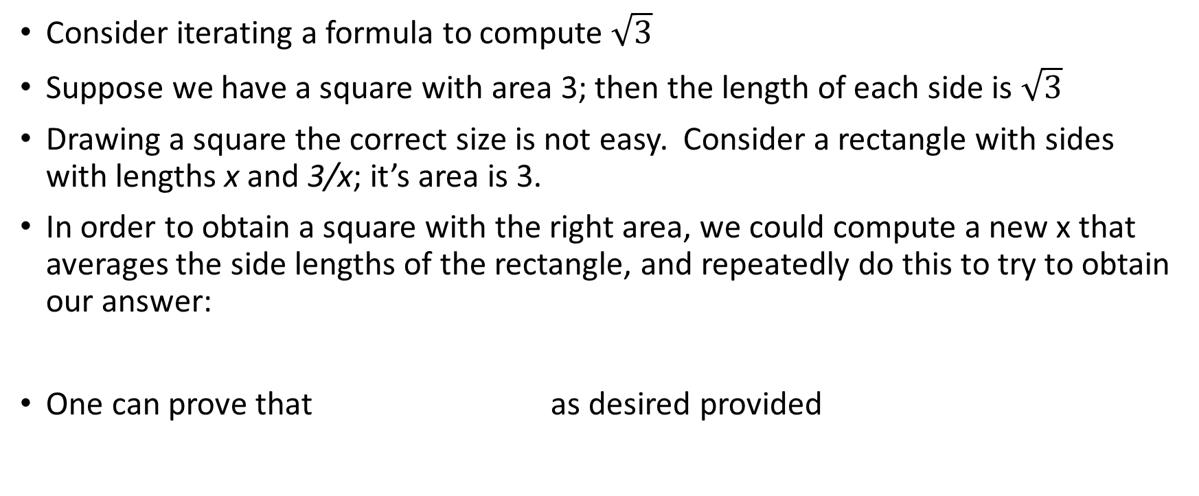
An example via iteration
Consider iterating a formula to compute $\sqrt{3}$
Suppose we have a square with area 3; then the length of each side is $\sqrt{3}$
Drawing a square the correct size is not easy. Consider a rectangle with sides with lengths x and 3/x; it’s area is 3.
In order to obtain a square with the right area, we could compute a new x that averages the side lengths of the rectangle, and repeatedly do this to try to obtain our answer:
One can prove that as desired provided

Slide 4
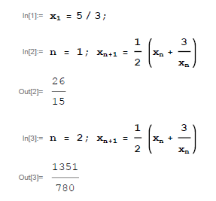
Symbolic version
Trying the iteration in Mathematica…
First two iterates:
The fraction is exact, but is getting more digits in the numerator and denominator

Slide 5
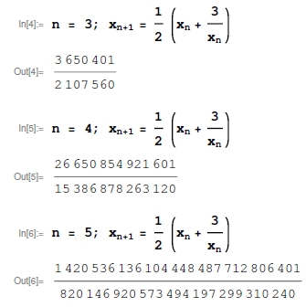
Symbolic version
Now the next three iterates:
The fraction is now getting many digits , and gets much worse very quickly: it roughly doubles with each step

Slide 6
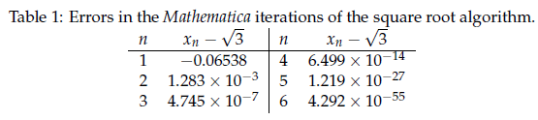
Symbolic version
How is the error doing? The error is the difference between the iterate and the exact answer
It is converging very well: note how the exponent is doubling each time!

Slide 7
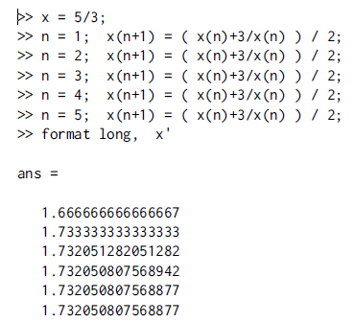
Numerical version
Now try the iteration in Matlab
Start with same guess
Each iterate has 16 digits, so the approximation doesn’t require more memory each time, but it is not exact.
Still, the answer converges to the correct answer within the ability of Matlab to represent the answer (not exact)

Slide 8
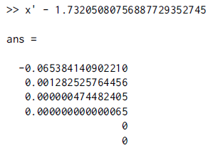
Numerical version
The error for all of the iterates is shown at right
The answer is too small to show with 16 digits and without scientific notation in just a few iterations
So, for a smaller amount of fixed memory, we can rapidly get good answers this way as well.

Slide 9
Consequences of numerical computing
Sometimes (not commonly) rules of arithmetic don’t hold
As a simple example, consider these two calculations which round the second decimal place. Only the grouping and thus order of operations changes.
The first results rounds to 1.11, while the second rounds to 1.12.
This can be exacerbated in certain problems or with certain (undesirable) algorithms.
We will study ways to avoid these problems, among other things.

